Slide 1
OPERATING SYSTEMS (CS F372) File System Implementation
Barsha Mitra
CSIS Dept., BITS Pilani, Hyderabad Campus

Slide 2
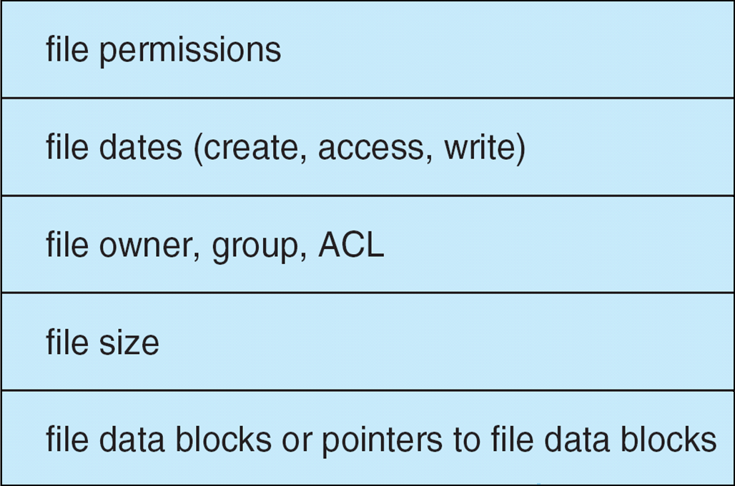
File System Implementation
File control block (inode in UNIX)–structure consisting of information about a file
Per-file File Control Block (FCB) contains many details about the file
unique identifier to allow association with a directory entry, permissions, size, dates

Slide 3
File System Implementation
Boot control block contains info. needed by system to boot OS from that volume
Needed if volume contains OS, usually first block of volume
Volume control block (superblock, master file table) contains volume/partition details
Total # of blocks, # of free blocks, block size, free block pointers, free-FCB count
Directory structure organizes the files

Slide 4
Directory Implementation
Linear list of file names with pointer to the data blocks
Simple to program
Time-consuming to execute
Linear search time
Could keep ordered alphabetically
Hash Table – linear list (for directory entries) with hash data structure
Decreases directory search time
Collisions – situations where two file names hash to the same location
Only good if entries are fixed in number, or use chained-overflow method

Slide 5
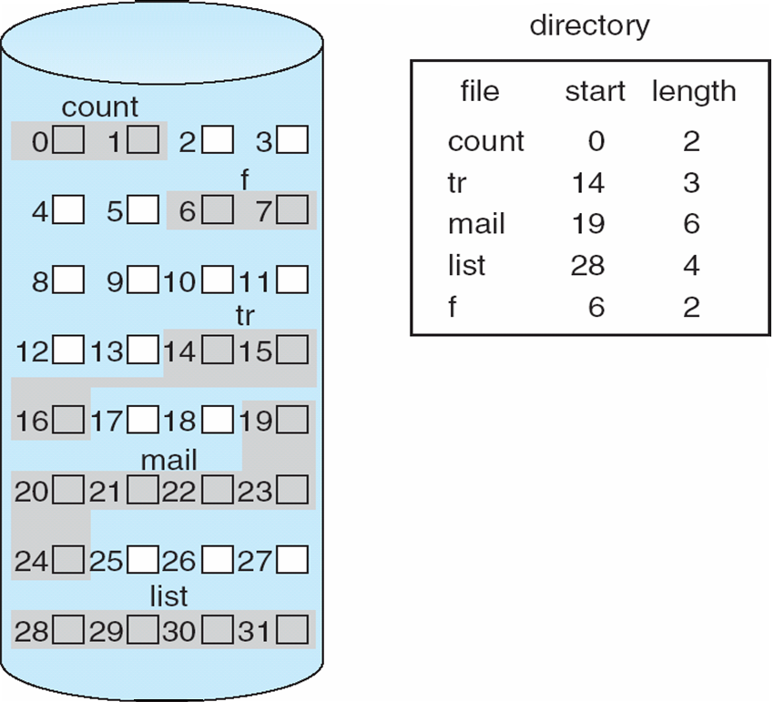
Allocation Methods - Contiguous
Allocation method refers to how disk blocks are allocated for files
Contiguous allocation – each file occupies set of contiguous blocks
Best performance in most cases
Simple – only starting location (block #) and length (number of blocks) are required
Problems include finding space for file, knowing file size, external fragmentation, need for compaction off-line (downtime) or on-line
Mapping from logical to physical

Slide 6
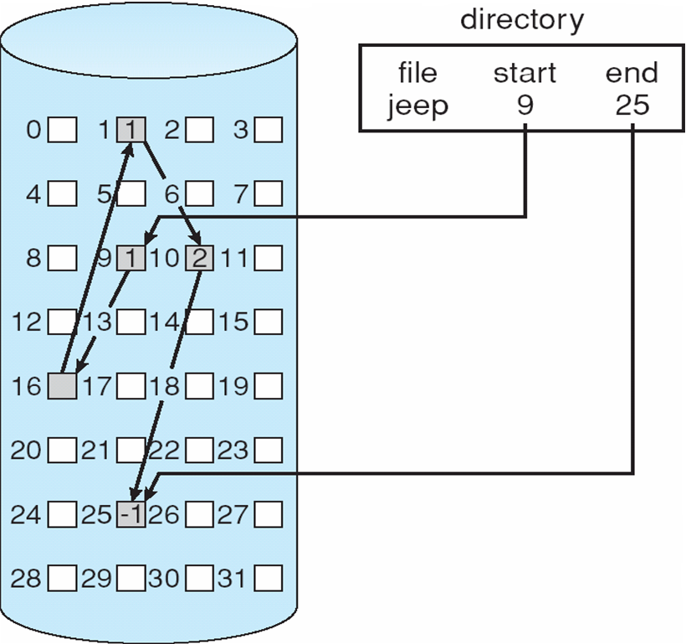
Allocation Methods - Linked
Linked allocation – each file is a linked list of blocks
File ends at nil/null pointer
Each block contains pointer to next block
No compaction, no external fragmentation
Free space management system called when new block needed
Improve efficiency by clustering blocks into groups
Reliability can be a problem
Locating a block can take many I/Os and disk seeks

Slide 7
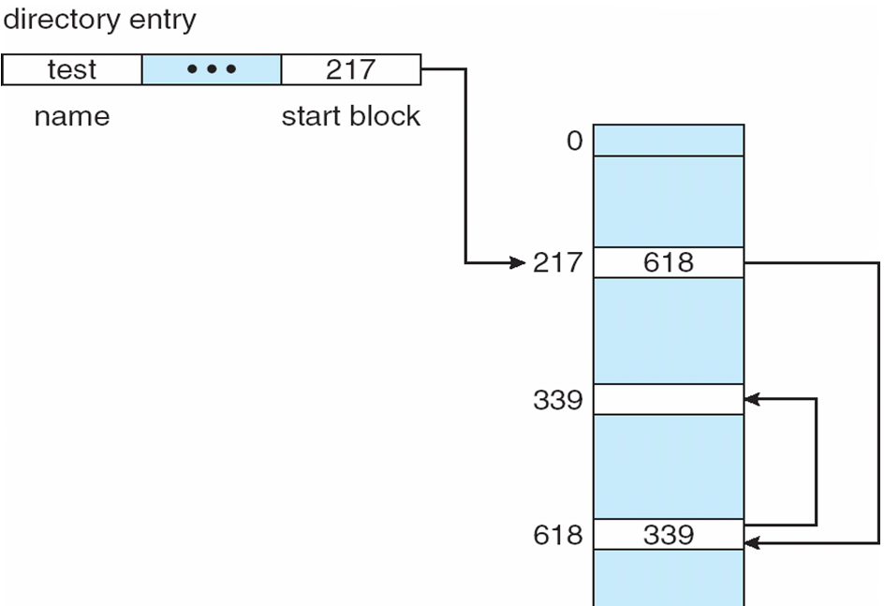
File Allocation Table
FAT (File Allocation Table)
Beginning of volume has table, indexed by block number
Much like a linked list
New block allocation simple

Slide 8
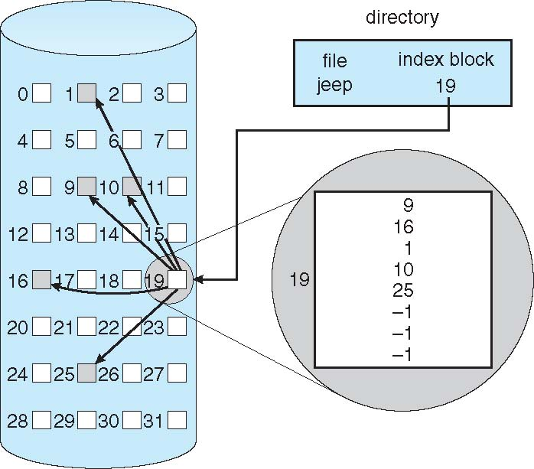
Allocation Methods - Indexed
Indexed allocation - Each file has its own index block of pointers to its data blocks
Need index table
Random access
Dynamic access without external fragmentation, but have overhead of index block

Slide 9
Free Space Management
File system maintains free-space list to track available blocks
Bit vector or bit map (n blocks)
0
1
2
n-1
…
1 ⇒ block[i] free
0 ⇒ block[i] occupied
bit[i] =

Block number calculation
(number of bits per word) *
(number of 0-value words) +
offset of first 1 bit
CPUs have instructions to return offset within word of first “1” bit

Slide 10
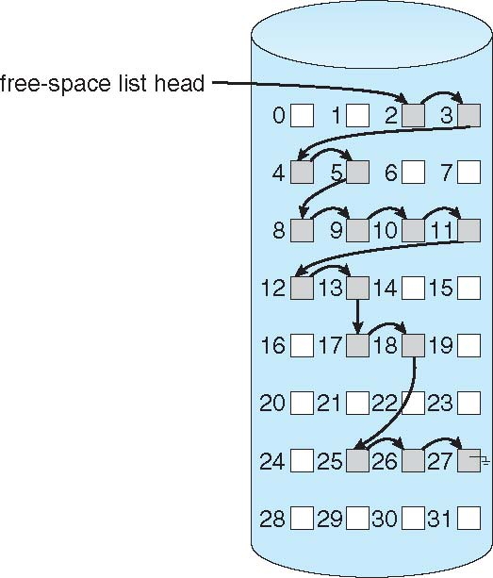
Linked List
Linked list (free list)
Cannot get contiguous space easily
No waste of space
No need to traverse the entire list

Slide 11
Thank You

